Slide 1
Installing IGV

Slide 2
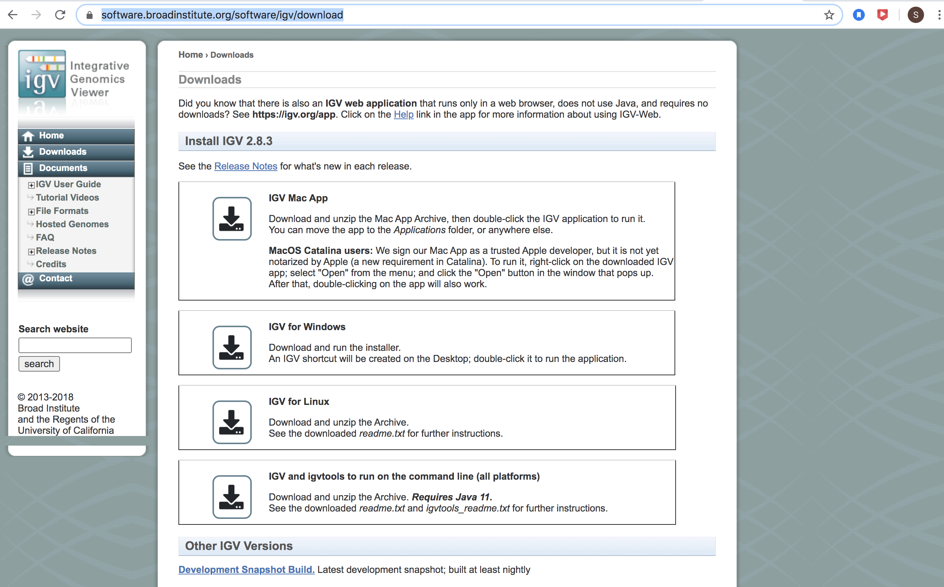
https://software.broadinstitute.org/software/igv/download

Slide 3
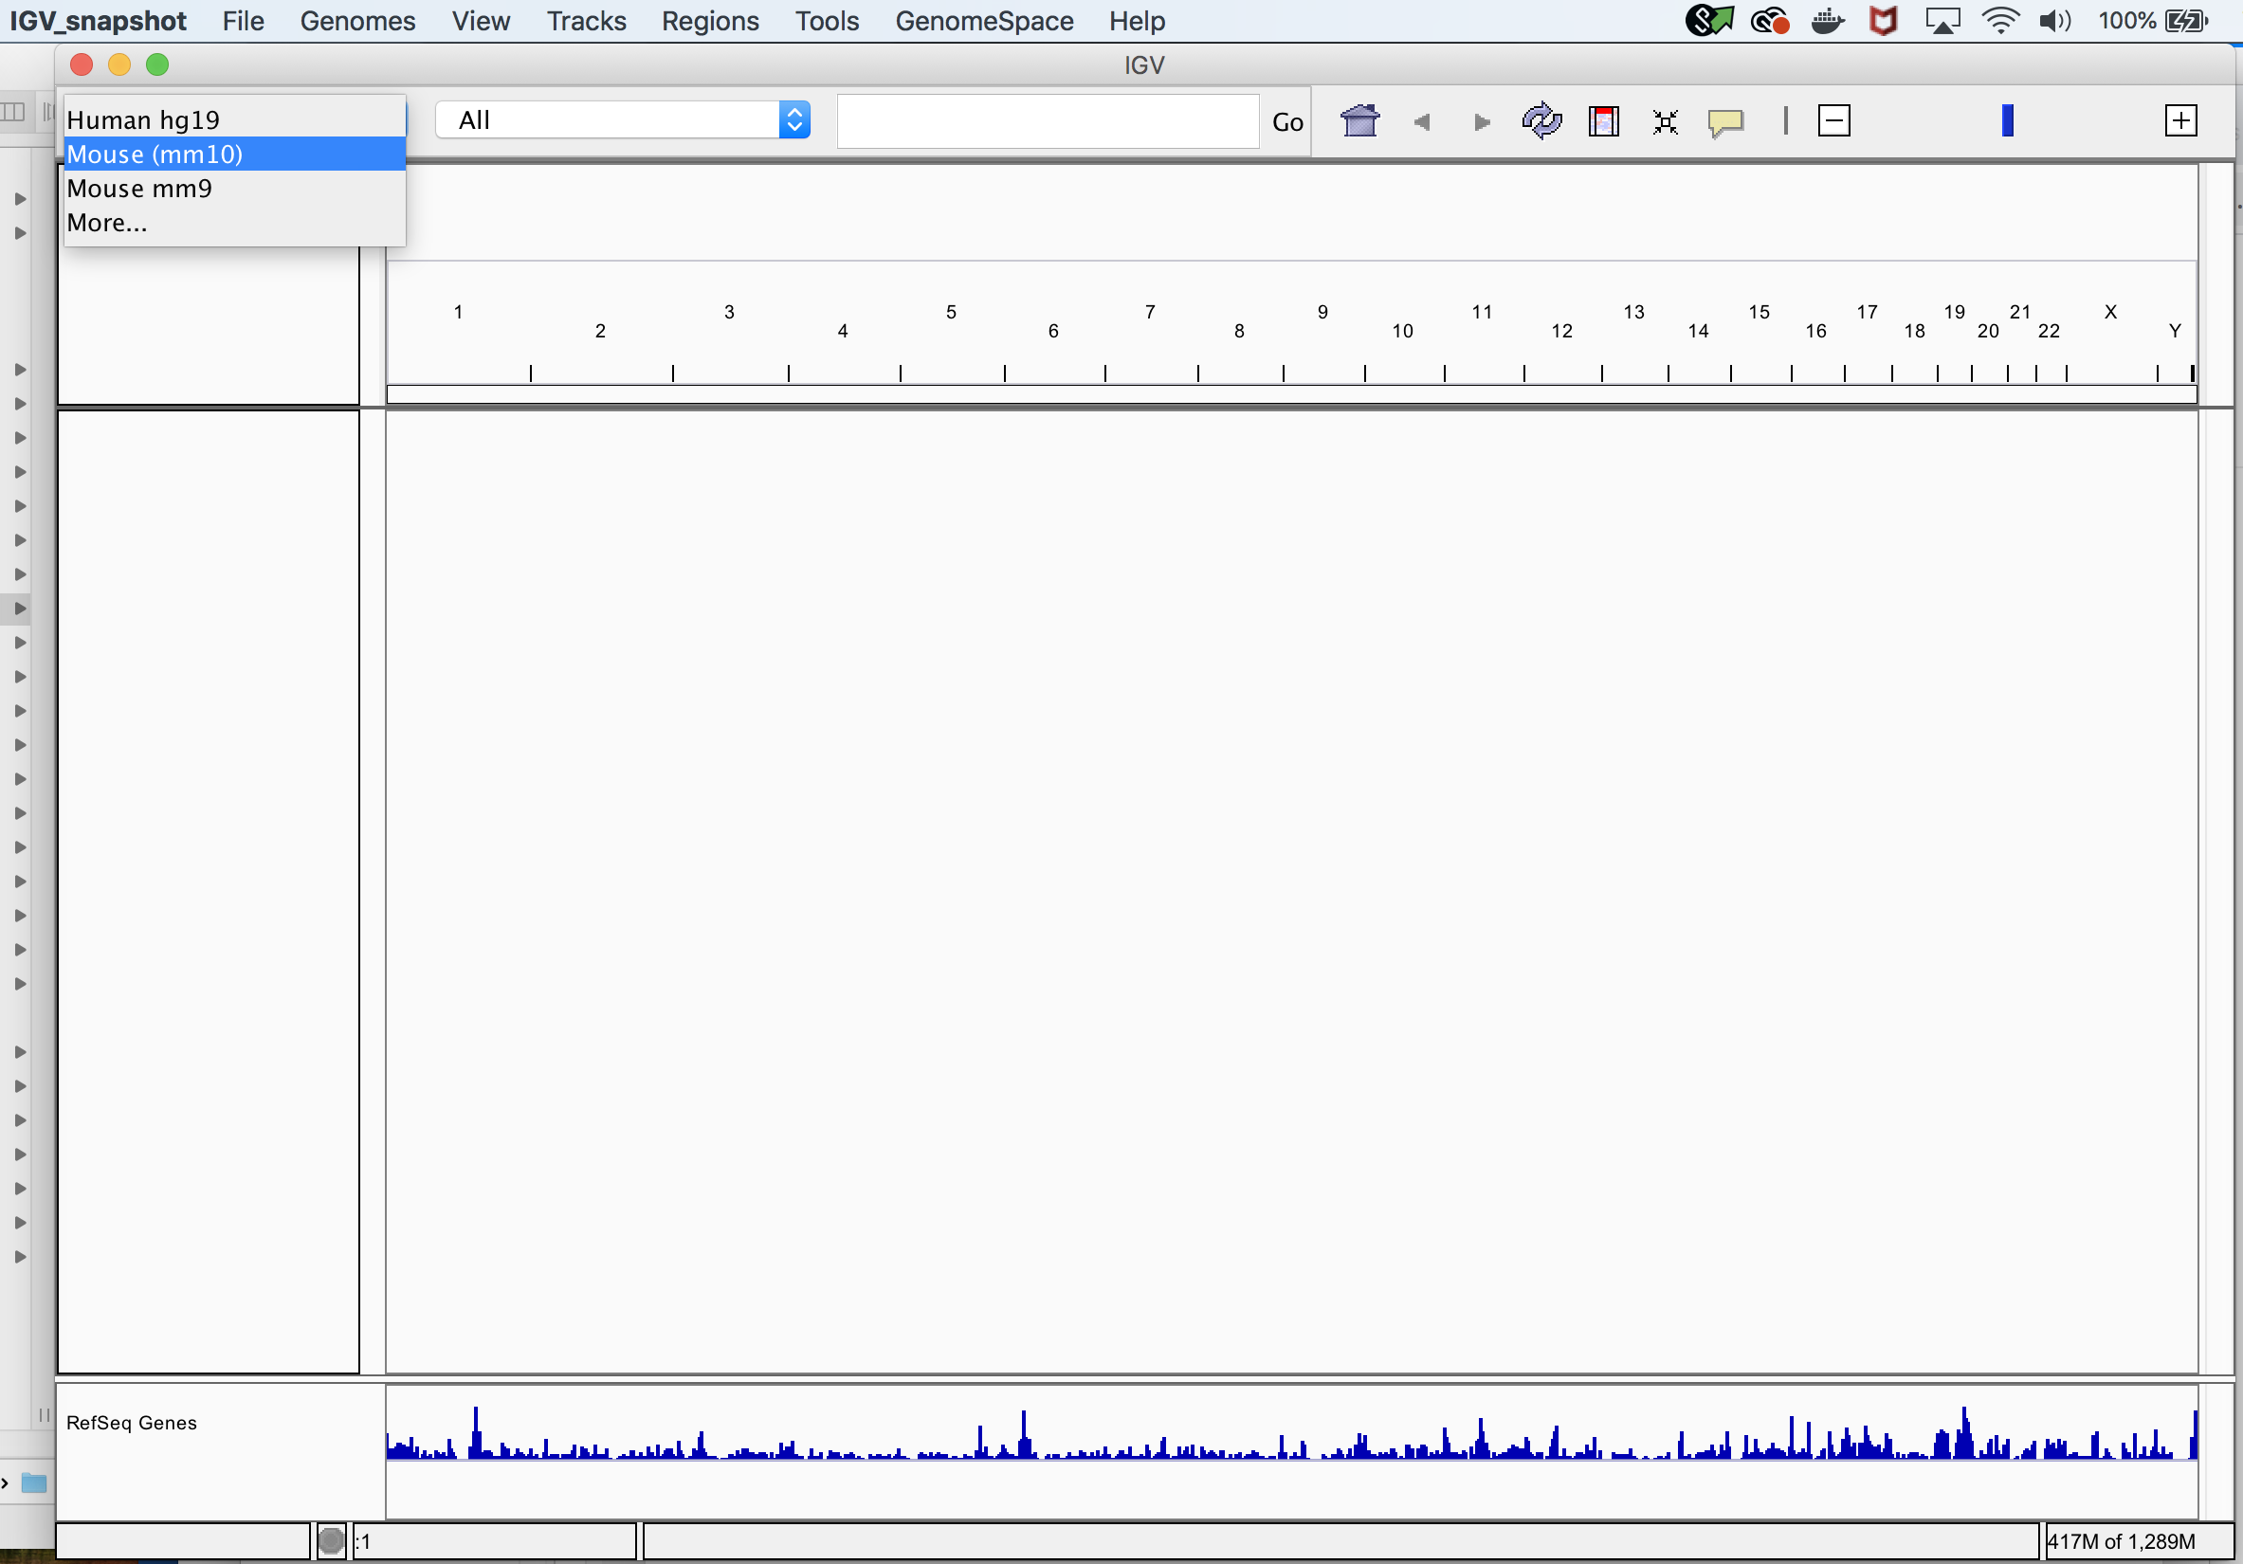
IGV tools can help you visualize bedgraph and bam files
Make sure genome is set to mm10

Slide 4
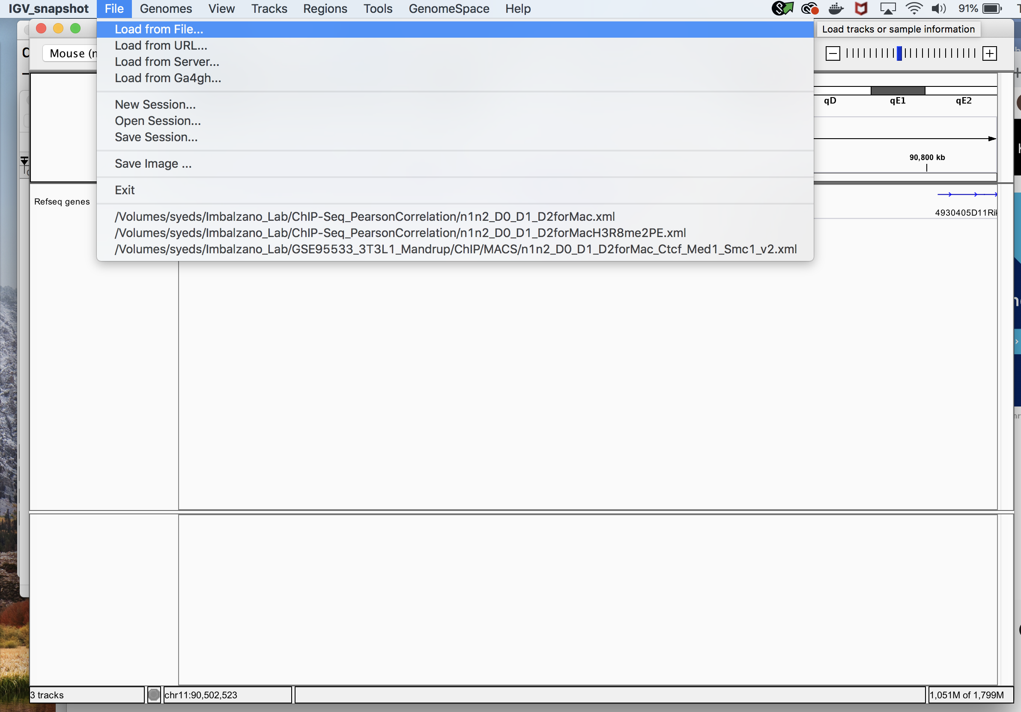

Slide 5
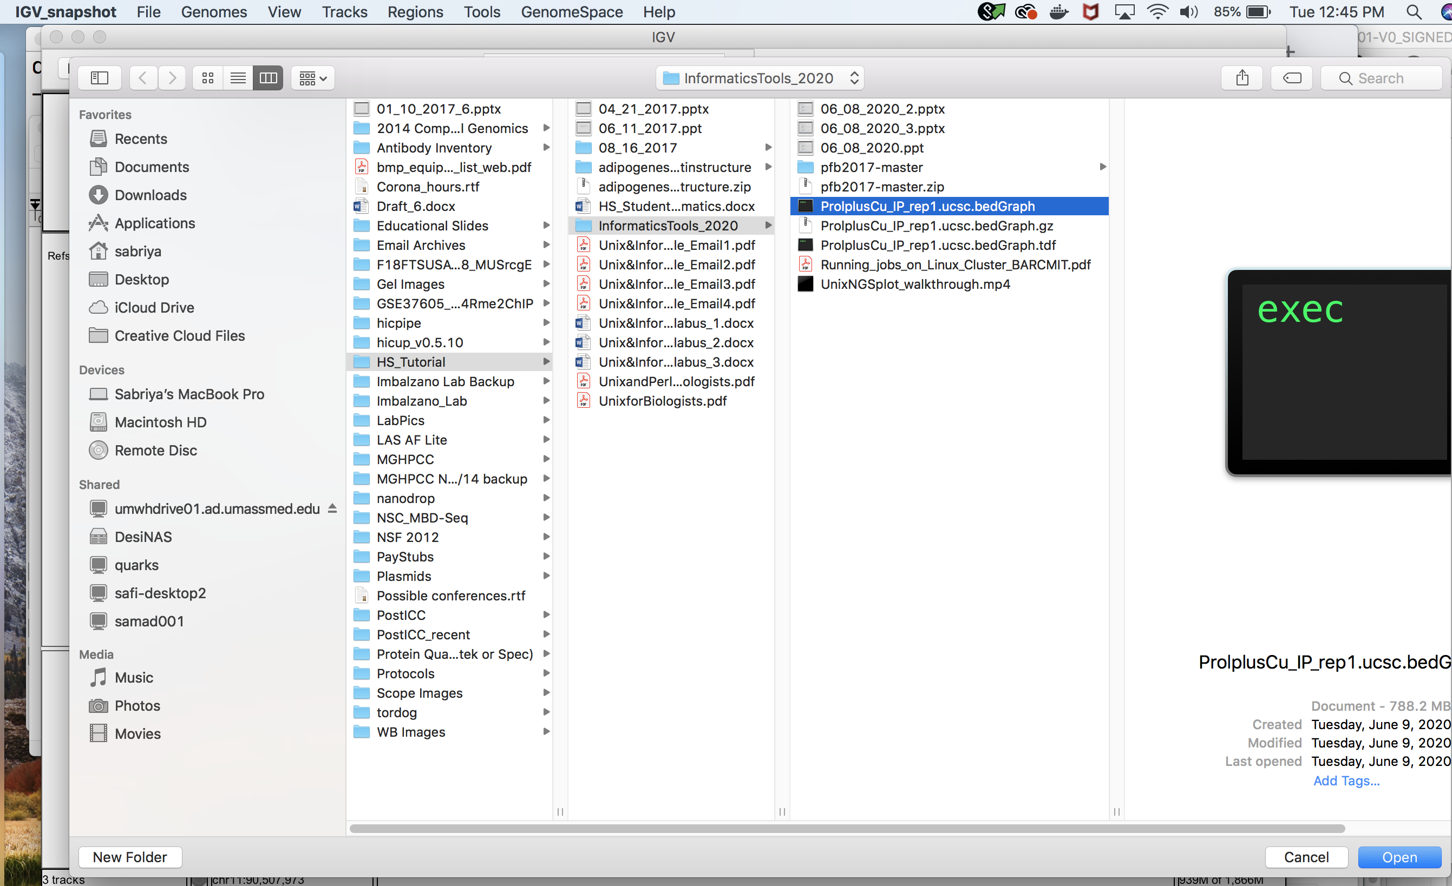
Load an unpacked version of Tere’s bedgraph file

Slide 6
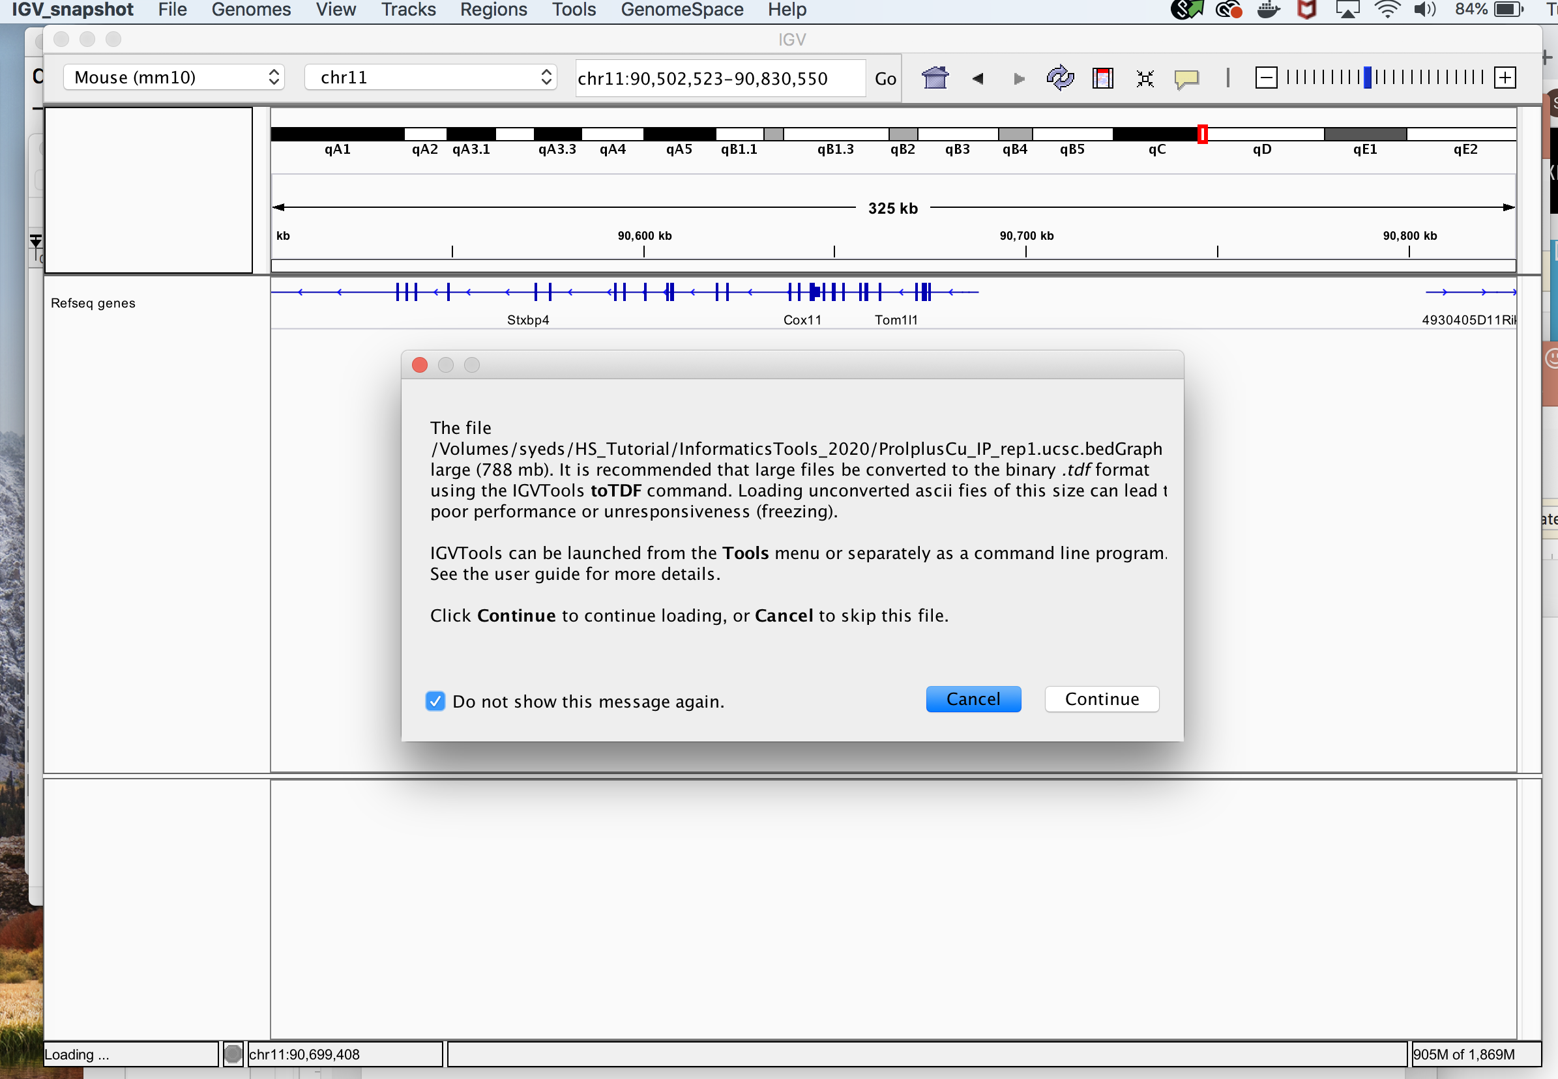
We will cover making TDF files later
Eventually, if you want to load multiple files together, you’ll need TDF files otherwise the file format will be too big

Slide 7
It will take several minutes for the bedgraph to load because of the size of the file

Slide 8
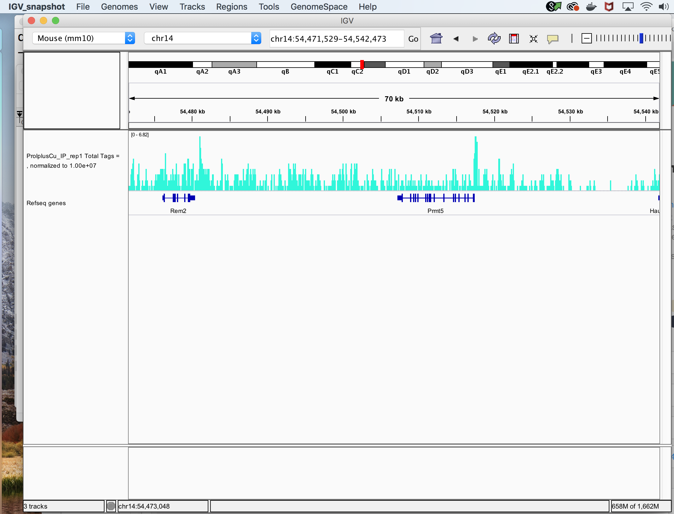

Slide 9
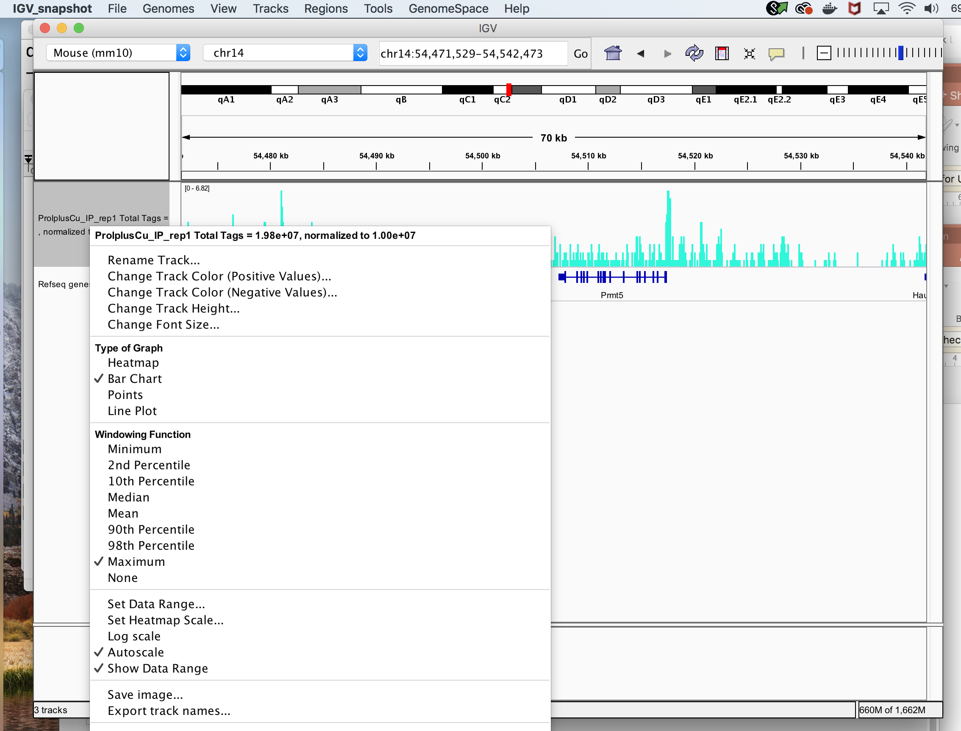
Right click on the left column to adjust track features

Slide 10
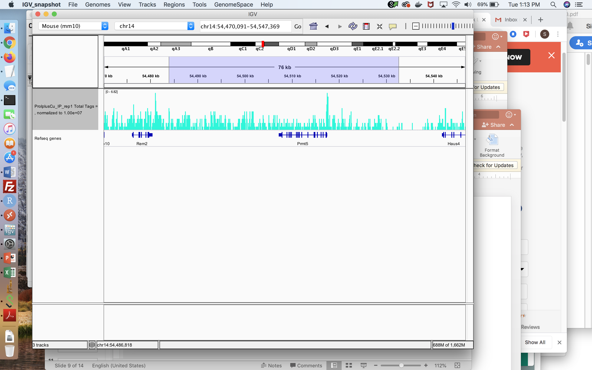
Click and drag along the kb window to zoom in on specific regions

